Slide 1
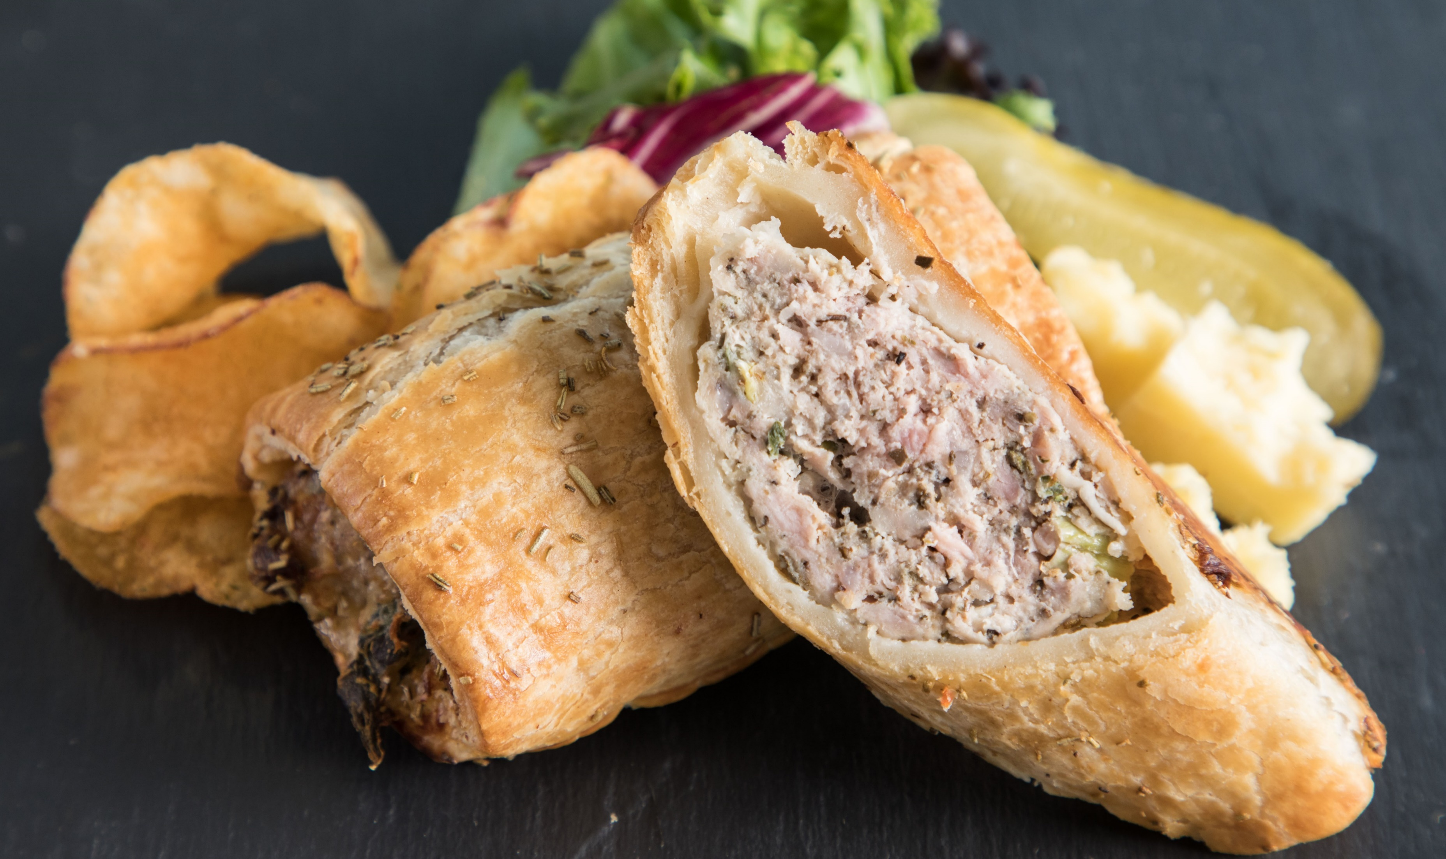
£27.00
20 x 160g
Click for more info

